Slide 1
A Gift of Fire Third edition Sara Baase
Chapter 2: Privacy

Slide 2
Privacy Risks and Principles

Slide 3
What is Privacy
There are three key aspects of privacy:
Freedom from intrusion (Entry to another's property without right or permission)
Control of information about oneself
Freedom from surveillance (being tracked, followed, watched, under observation, investigation)

Slide 4
Privacy threats Categories
Privacy Threats come in several categories:
Intentional/institutional uses of personal information (Primarily for law enforcement and tax collection in the government sector and for marketing and decision making in the private sector by both government and organizations).
Unauthorized use of release by “insiders”, the people who maintain the information
Theft of information
Inadvertent leakage of information through negligence or carelessness
Our own actions (sometimes intentional trade-offs and sometimes when we are unaware of risks)

Slide 5
New Technology, New Risks
Government and private databases (searching data re-identification is easy)
Sophisticated tools for surveillance and data analysis (smart phones send location)
Location data should be Anonymous but it stores phone ID, age and gender info and sent to 3rd parties.
Hidden data in mobile phones
Vulnerability (Susceptible to attack) of data to loss, hacking, and misuse:

Slide 6
New risks
Anything we do in cyberspace is recorded, at least briefly, and linked to our computer or phone, and possibly our name.
With the huge amount of storage space available, companies, organizations, and governments save huge amounts of data that no one would have imagined saving in the recent past.
People often are not aware of the collection of information about them and their activities.
Software is extremely complex. Sometimes businesses, organizations, and website managers do not even know what the software they use collects and stores.
Leaks happen. The existence of the data presents a risk.

Slide 7
New risks
A collection of many small items of information can give a fairly detailed picture of a person’s life.
Direct association with a person’s name is not essential for compromising privacy. Re-identification has become much easier due to the quantity of personal information stored and the power of data search and analysis tools.
If information is on a public website, people other than those for whom it was intended will find it. It is available to everyone. Once information goes on the Internet or into a database, it seems to last forever. People (and automated software) quickly make and distribute copies. It is almost impossible to remove released information from circulation.
It is extremely likely that data collected for one purpose (such as making a phone call or responding to a search query) will find other uses (such as business planning, tracking, marketing, or criminal investigations).

Slide 8
Terminology and principle for managing personal Information
1.Informed consent and Invisible information gathering – collection of personal information about someone without the person’s knowledge (spyware, event data recorders in cars, customer ID number in software of cursor, finger printing)
Example:
A company offered a free program that changed a Web browser’s cursor into a cartoon character. Millions of people installed the program but then later discovered that the program sent to the company a report of the websites its users visited, along with a customer identification number in the software

Slide 9
Terminology and principle for managing personal Information
2.Secondary use, data mining, matching, and profiling – use of personal information for a purpose other than the one it was provided for.
Data mining - searching and analyzing masses of data to find patterns and develop new information or knowledge
Computer matching - combining and comparing information from different databases (using social security number, for example, to match records)
Computer profiling - analyzing data in computer files to determine characteristics of people most likely to engage in certain behavior

Slide 10
Control of Secondary use of personal information (SUPI)
The degree of control one should have over its SUPI.
After informing people what info is collected and what it does with it.
Then give control over SUPI through Informed consent (IS)
Two forms of IS are Opt-in & Opt-out policies
Opt-out by default information will be used.(opt for not use)
Opt-in by default info will not be used.(opt for use)
Data retention (Allow to remain in a place or position or maintain a property or features)

Slide 11
Fair Information Principles or practices for managing personal data
1. Inform people when you collect information about them, what you collect, and how you use it.
2. Collect only the data needed.
3. Offer a way for people to opt out from mailing lists, advertising, and other secondary uses. Offer a way for people to opt out from features and services that expose personal
information.
4. Keep data only as long as needed.
5. Maintain accuracy of data. Where appropriate and reasonable, provide a way for people to access and correct data stored about them.
6. Protect security of data (from theft and from accidental leaks). Provide stronger protection for sensitive data.
7. Develop policies for responding to law enforcement requests for data.

Slide 12
Fair Information Principles or practices for managing personal data
Laws in US, Canada, and Europe using them as ethical practices in many situations but gives custody when court order comes.
There is a wide variation and in interpretation among business and privacy advocates (what info business need and for how long)
Difficult to determine the purpose of supplying info: the increase of cameras used by police or google street view, sent on tweets.
Notes:
If the class doesn't mention it, make sure to mention that online opt-in choices may be pre-checked and require you un-checking the box to avoid opting in.
Be sure to mention the "subject to change without notice" clause found in most privacy policies.

Slide 13
The Fourth Amendment, Expectation of Privacy, and Surveillance Technologies

Slide 14
"Big Brother is Watching You“
George Orwell’s dystopian
(A work of fiction describing an imaginary place where life is extremely bad because of deprivation, oppression or terror) novel 1984, Big brother could watch every one via “tele-screens” in all homes and public places.
Today, it does not have to watch every move we make, because so many of our activities leave data trials in databases available to government agencies.

Slide 15
The Fourth Amendment
US constitution protects a right to privacy from government intrusion. (even Europe)
It requires that the government have probable cause for the search and seizure (The act of taking of a person by force).
Federal privacy rules allow law enforcement agencies to access medical records without a court order.
The USA PATRIOT Act passed after (9/11) eased government access to Personal info with out court order.

Slide 16
Cont.
PROBLEM: weakening factor for 4th amend. : using new technology govt. can search homes with out physically entering into them.
Search home – with out entering them
Search persons – from distance with out our knowledge
Extract all the data -- on cell phone (even deleted passwords) in 2 minutes ☹

Slide 17
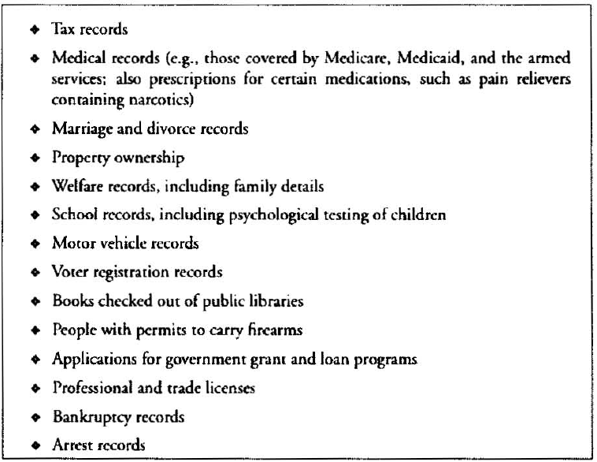
Government databases with personal information

Slide 18
Search and Seizure of Computers and Phones
National Association for Advancement of Colored People (NACCP)
The NAACP’s membership list was not on a computer in the 1950s. It undoubtedly is now. SC ruling against the Alabama state.
Privacy in group association may be essential to preservation of freedom of association, particularly where a group adopts disagree beliefs.
4th am. Requires search warrants be specific about the Object of the search or seizure.
Court says officers allowed to observe situation in plain view and report if suspect found.
PROBLEM: Access computer is serious threat to privacy, liberty, and FOS

Slide 19
Plain View
the rule that a law enforcement officer may make a search and seizure without obtaining a search warrant if evidence of criminal activity or the product of a crime can be seen without entry or search. Example: a policeman stops a motorist for a minor traffic violation and can see in the car a pistol or a marijuana plant on the back seat, giving him "reasonable cause" to enter the vehicle to make a search.

Slide 20
Cont.
Interpretation of information in plain view
All un encrypted files on Phones and Laptops-invites abuse.
Court view: if officer see evidence of another crime at plain view, the officer may seize and use it. Could be used for “fishing expeditions” for other information (An investigation undertaken in the hope (but not the stated purpose) of discovering information).
PROBLEM: Fishing expeditions - Crosses 4th am that “Warrant be Specific”

Slide 21
Cont.
Phones and Laptops:
Police can search an arrested person (with out warrant) and examine its property on the person or within his reach.
Can mobile phones be searched ? they may contain proprietary/confidential info e.g. lawyer’s phone.
Vast collection of info on phone is kind of info 4th am. is intended to protect.
Ohio’s SC + Judge Ruling: Searching an arrested persons phone (retrieving info) with out search warrant is illegal as people have expectation of privacy for their phone contents
California SC ruled: info retrieval is permitted as phone is personal property found on arrested person.

Slide 22
Video Surveillance and Face recognition
People aware surveillance areas (banks, convenience stores, prisons, gambling casinos, traffic and catch drivers)
After 2001 terrorist attacks, installation of high zoomed cameras ½ mile range.
Spy Surveillance: Cameras + face recognition apps violate civil liberty issues.
Police in Tampa Florida scan faces of 1lac fans and employees in Super Bowl (snooper/spy). Then matches computer files criminal matches in their DB of suspects.
In two years of no wanted recognized. (Face rec poor accuracy in 2001)

Slide 23
Marketing and personalization
Marketing: biggest use of personal information. It includes finding new customers.
Personalization: make recommendation based on prior purchase. Personalization of ads.
Consumer Dossiers: Collection of consumer history.
Targeted marketing
Data mining
Paying for consumer information
Data firms and consumer profiles

Slide 24
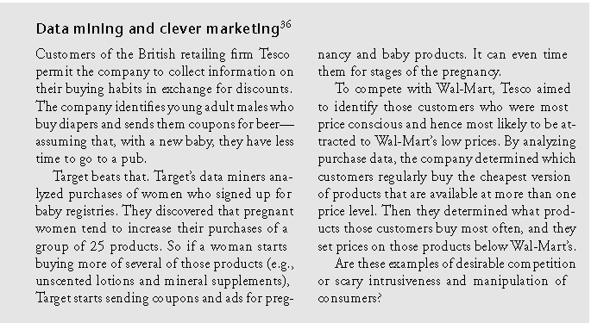
Case study

Slide 25
Our Social and Personal Activity
Polls show that people care about privacy.
Why don’t they act that way?

Slide 26
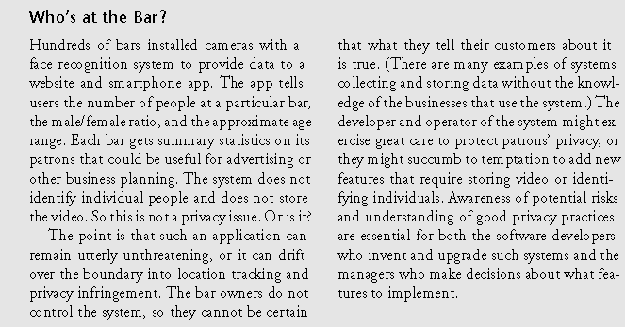
Location Tracking

Slide 27
(cont.)
Stolen and Lost Data:
Hackers
Except for hackers, these are not new to computer technology. Before computers, files were stolen, receipts were stolen, information was requested under false pretenses and employees were bribed. But, with computers, the extent and impact have grown.
Physical theft (laptops, thumb-drives, etc.)
Requesting information under false pretenses (false appearance)
Bribery (The practice of offering something usually money in order to gain an outlawed advantage) of employees who have access

Slide 28
A Right to be Forgotten
Legislators and privacy advocates are promoting a legal right to demand that websites remove material about oneself as a legal and ethical right.
Complying with the request could be ethically acceptable and admirable but not ethically obligatory.
Some companies provide free services on the cost of using our data and some give totally free services or at discount on viewing ads.
Right to be forgotten could be taken as negative right (liberty: to stay off internet) or a positive right (claim: removal of posts). Can conflict FOS?
Other may not write about a person or exchange specified information about the person – information gained with out violating any of the person’s rights.
Parents may request legally to remove unethical contents posted by their children.

Slide 29
Databases
National ID System:
Social Security Numbers
Too widely used
Easy to falsify
A new national ID system - Pros
would require the card
harder to forge (copy)
have to carry only one card
A new national ID system - Cons
Threat to freedom and privacy
Increased potential for abuse

Slide 30
Discussion Questions
Is there information that you have posted to the Web that you later removed? Why did you remove it? Were there consequences to posting the information?
Have you seen information that others have posted about themselves that you would not reveal about yourself?

